Slide 1
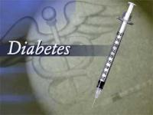

Slide 2
What is Diabetes Mellitus?
Normal Glucose Metabolism:
When the amount of glucose in the blood increases, e.g., after a meal, it triggers the release of the peptide hormone insulin from the pancreas.
Insulin stimulates muscle and fat cells to take-in glucose from the blood and stimulates the liver to metabolize glucose, causing the blood sugar level to decrease to normal levels.
Diabetes Mellitus -
Diabetes mellitus is a metabolic disorder characterized by abnormally high levels of sugar (glucose) in the blood.
Condition of high levels of glucose in the blood is called Hyperglycemia.
Hereditary and environmental factors are responsible.

Slide 3
Causes of Hyperglycemia
Insulin is a hormone secreted from the Islet cells of the
Pancreas.
Insulin enables cells to absorb glucose in order to turn it
into energy, thereby keeping the normal blood glucose
level in the blood.
In diabetes, blood sugar levels remain high, may be because insulin
  -- is not being produced at all
  -- is not made at sufficient levels, or
  -- is not as effective as it should be.
This causes glucose to accumulate in the blood, often leading to various complications.

Slide 4
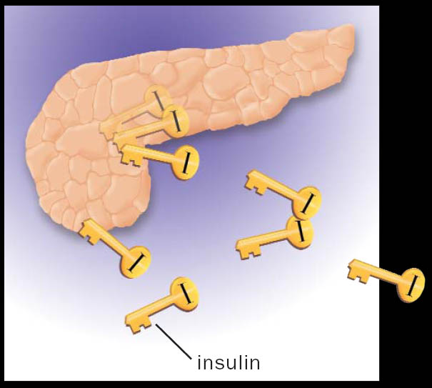
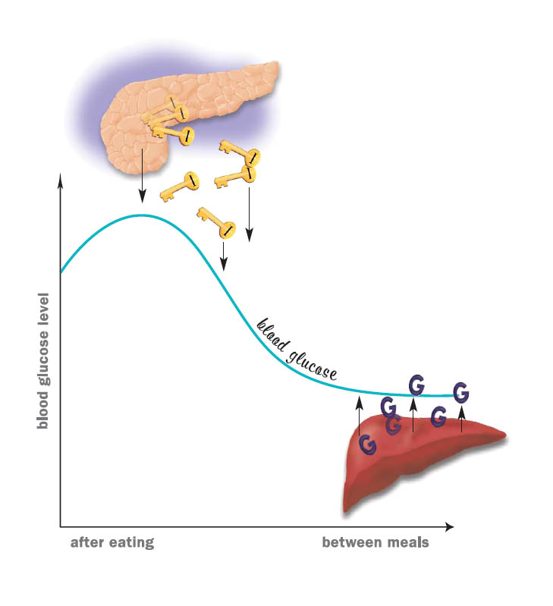
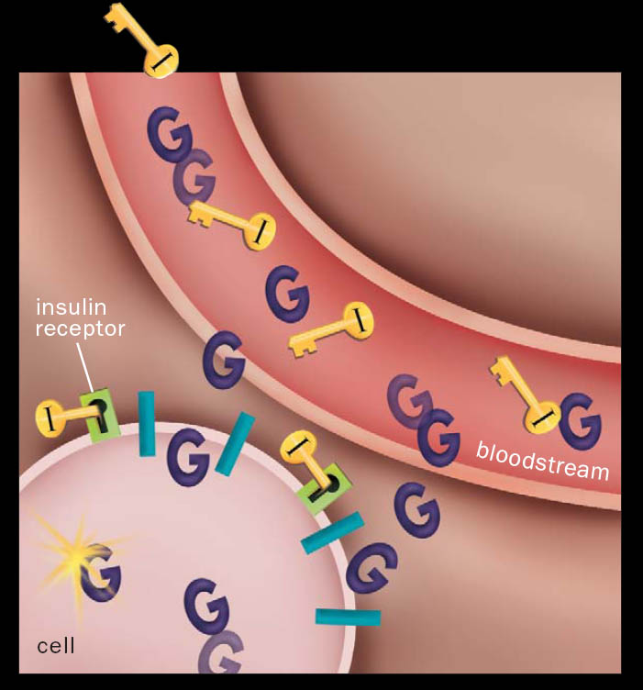
When you eat, your body breaks food down into glucose. Glucose is a type of sugar that is your body’s main source of energy.
As blood glucose rises, the body sends a signal to the pancreas, which releases insulin.
As your blood glucose rises (after a meal), the pancreas releases insulin.
Blood glucose goes up and down throughout the day
Acting as a key, insulin binds to a place on the cell membrane (an insulin receptor), unlocking the cell so glucose can pass into it. There, most of the glucose is used for energy right away.

Slide 5
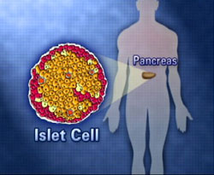
If insufficient/lack of insulin
Glucose can’t enter the cell
Glucose remains in blood
Diabetes Mellitus/Hyperglycemia

Slide 6
Types of Diabetes
There are mainly three types of diabetes:
Type I or insulin dependent diabetes often called juvenile onset diabetes,
Type II or non-insulin dependent diabetes often called adult onset diabetes &
Gestational diabetes (GDM) – during pregnancy
The most common forms of diabetes are type 1 diabetes (5%), which is an autoimmune disorder and type 2 diabetes (95%), which is associated with obesity.
Gestational diabetes is a form of diabetes that occurs during pregnancy.

Slide 7
Type 1 diabetes:
  Most commonly occurs in children
  Is a result of the body's immune system attacking and destroying the beta islet cells.
  The trigger for this autoimmune attack is not clear, but the result is the end of insulin production.
Type 2 diabetes:
  Type 2 diabetes commonly occurs in adults who are obese.
  There are many underlying factors that contribute to the high blood glucose levels in these individuals.
  An important factor is the body's resistance to insulin, essentially ignoring its insulin secretions.
  A second factor is the falling production of insulin by the beta cells of the pancreas.
  Therefore, an individual with type 2 diabetes may have a
  combination of deficient secretion and deficient action of
  insulin.

Slide 8
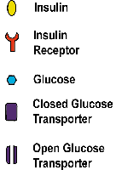
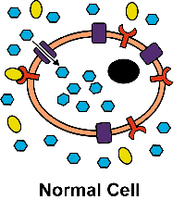
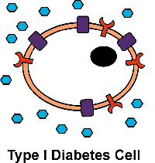
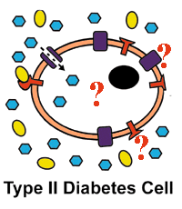
Type I & II Diabetes : Insulin Response
This is a normal
cell.
Insulin is present
and is taken into
the cell to
facilitate proper
glucose uptake.
In Type I diabetes,
insulin is not
produced; so,
there is nothing
to signal the
cells to take in
glucose
and metabolize it.
Here, insulin is
present, but signal
for proper glucose
uptake & metabolism
is lost. The problem
could be in the insulin
itself or in any one
of the proteins involved
in glucose uptake and
metabolism.

Slide 9
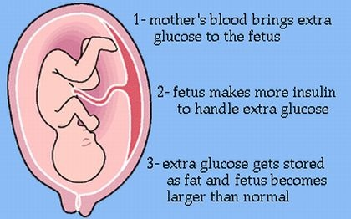
Gestational Diabetes- 3rd Type of Diabetes
Gestational diabetes is diabetes that happens for the first time when a woman is pregnant. Gestational diabetes goes away when any woman has her baby, but it increases her risk for having diabetes later.

Slide 10
Due to Gestational Diabetes, the baby has risks for-
1) Macrosomia - refers to a baby that is considerably larger than normal.
2) Birth injury - may occur due to the baby's large size and difficulty being born.
3) Hypoglycemia – refers to low blood sugar in the baby immediately after delivery.
4) Respiratory distress- difficulty in breathing.

Slide 11
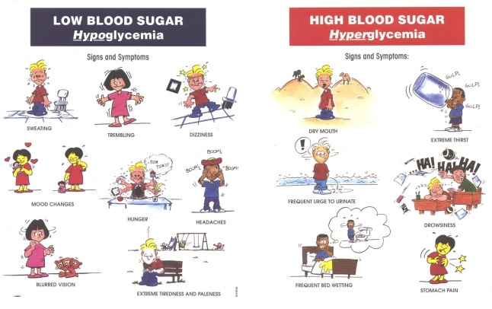
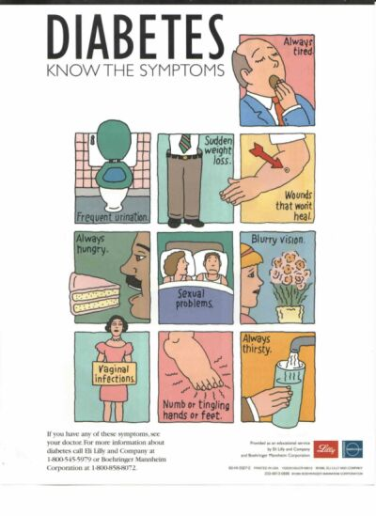
Signs & Symptoms
Sudden
Weight
Loss
gulp
gulp
gulp
Always
Hungry
Dry Mouth
Extreme Thirst
Frequent Urination
Always Tired
Wounds that
won’t heal
Frequent Bed wetting
Stomach Pain

Slide 12
Diagnosis
Diabetes is diagnosed by measuring the blood glucose level during fasting (Fasting plasma glucose test) or an oral glucose tolerance test. (OGTT).
Three status associated with diabetes: people who are not diabetic; those with Impaired Glucose Tolerance (IGT); and those with diabetes.
Category | Blood Glucose (mg/dL)
 | Fasting | After meal
Normal | <115 | <140
Diabetic | >140 | >200
Impaired Glucose Tolerance | <140 | 140-199

Slide 13
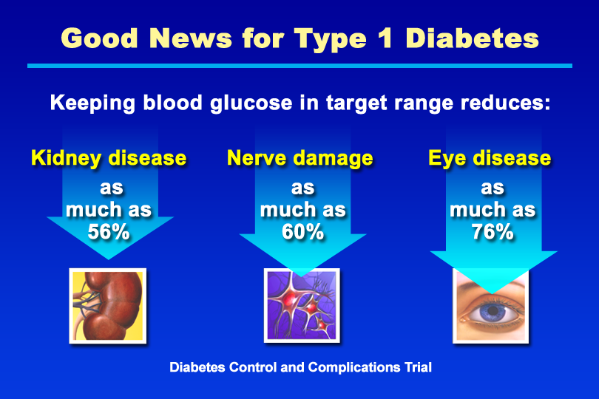
Good News for Type 1 Diabetes
Nephropathy Neuropathy Retinopathy
Notes:
KEY MESSAGE: The DCCT showed that people with type 1 diabetes who followed an intensive therapy regimen that lowered their A1c values had fewer long-term complications.
Supporting Points
The DCCT is the longest and largest study to show that lowering blood glucose to improve A1c results slows or prevents the development of complications in type 1 diabetes. The DCCT examined more than 1,400 people with type 1 diabetes for 10 years. Two groups of patients were followed: one treated conventionally and another treated intensively. The volunteers in the intensive treatment group tested their blood more often and followed a more stringent schedule for insulin injection (multiple daily insulin injections or treatment with an insulin pump). Compared with people who had conventional therapy, the intensive treatment group had 35% to 56% less kidney damage (decreases in microalbuminuria and albuminuria, respectively), 60% less nerve damage (clinical neuropathy), and 76% less eye disease (retinopathy).
Improved glycemic control also was associated with fewer cardiovascular events in the DCCT. However, this finding was not statistically significant, perhaps because the study volunteers were young adults in whom the incidence of heart disease would be expected to be low.

Slide 14
Lipid profile

Slide 15
What is a lipid profile?
A lipid profile or lipid panel is a panel of blood tests used to find abnormalities in blood lipid ( such as cholesterol and triglycerides) concentrations. The lipid profile is a group of tests that are often ordered together to determine risk of coronary heart disease. The tests that make up a lipid profile are tests that have been shown to be good indicators of whether someone is likely to have a heart attack or stroke caused by blockage of blood vessels (hardening of the arteries), can identify certain genetic diseases, certain forms of pancreatitis, and other diseases.
looking for information about the amounts of four types of fats in the blood.

Slide 16
What tests are included in a lipid profile?
The lipid profile includes:
Total cholesterol,
HDL-cholesterol (often called good cholesterol),
LDL-cholesterol (often called bad cholesterol),
VLDL-cholesterol (This type of cholesterol carries triglycerides) and
Triglycerides (TG).
Sometimes the report will include additional calculated values such as the Cholesterol:HDL ratio or a risk score based on lipid profile results, age, sex, and other risk factors.
Notes:
Low density lipoproteins (LDL) are often called “the bad cholesterol“, because they can build plaque in the walls of your arteries, causing atherosclerosis.

Slide 17
A lipid panel measures five different types of lipids from a blood sample, including:
Total cholesterol: This is your overall cholesterol level — the
combination of LDL-C, VLDL-C and HDL-C.
Low-density lipoprotein (LDL) cholesterol: This is the type of cholesterol that’s known as “bad cholesterol.” It can collect in your blood vessels and increase your risk of cardiovascular disease.
Very low-density lipoprotein (VLDL) cholesterol: This is a type of cholesterol that’s usually present in very low amounts when the blood sample is a fasting samples since it’s mostly comes from food you’ve recently eaten. An increase in this type of cholesterol in a fasting sample may be a sign of abnormal lipid metabolism.
High-density lipoprotein (HDL) cholesterol: This is the type of cholesterol that’s known as “good cholesterol.” It helps decrease the build-up of LDL in your blood vessels.
Triglycerides: This is a type of fat from the food we eat. Excess amounts of triglycerides in your blood are associated with cardiovascular disease and pancreatic inflammation.
Notes:
herefore, VLDL-C is calculated by dividing the concentration of triglycerides (mg/dL or mmol/dL) by 5 or 2.26, respectively (equation III). Then, LDL-C is estimated by subtracting the concentration of HDL-C and calculated VLDL-C from the concentration of total cholesterol

Slide 18
Cholesterol helps the body form hormones, vitamin D and other important substances, but too much of it in the blood can clog and damage the blood vessels. Because it is a fat-like substance that doesn't mix with blood, cholesterol has to combine with proteins to form lipoproteins. Lipoproteins can travel in the blood to all the organs and tissues of the body.
Low-density lipoproteins (LDLs, or "bad" cholesterol) build up in the blood and increase your risk of heart disease.
High-density lipoproteins (HDLs, or "good" cholesterol) carry cholesterol to the liver, where it is removed from the body.
Triglycerides store energy for your body to use when it is needed. If there is too much, it can block blood vessels and cause other health problems such as abdominal pain and pancreatitis.

Slide 19
How is a lipid profile used?
The lipid profile is used to guide providers in deciding how a person at risk should be treated. The results of the lipid profile are considered along with other known risk factors of heart disease to develop a plan of treatment and follow-up.

Slide 20
It's important to know the ranges....
Total Cholesterol (lower is better)
Best = <200 mg/dL
Borderline high = 200-239 mg/dL
High = 240 mg/dL or higher
Triglycerides (lower is better)
Best = <150 mg/dL
Borderline high = 150-199 mg/dL
High = 200-499 mg/dL
Very high = 500 mg/dl or higher
LDL Cholesterol (lower is better)
Best = <100 mg/dL
Good = 100-129 mg/dL
Borderline high = 130-159 mg/dL
High = 160-189 mg/dL
Very high = 190 mg/dL or higher
HDL Cholesterol (higher is better)
Low = <40 mg/dL
Best = 60 mg/dL or higher

Slide 21
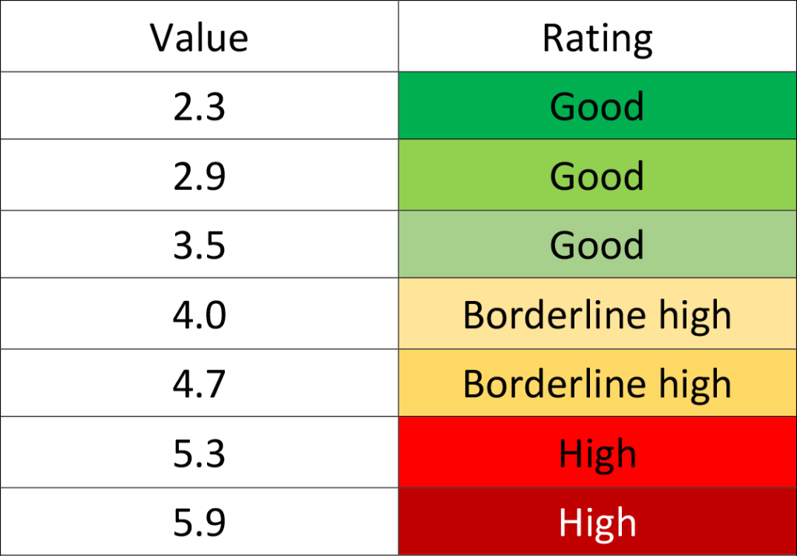
What is cholesterol ratio?
Cholesterol ratio (CR) is calculated by dividing your total cholesterol by the amount of high-density lipoproteins (HDL) in your blood. It is recommended that your cholesterol ratio stays under 5, with the ideal value being 3.5. Essentially, as your cholesterol ratio increases, so does the risk of you getting a heart disease.
CR = TC ÷ HDL
A desirable ratio is 5:1, and an optimal ratio is 3.5:1. The lower this number is, the healthier a person's cholesterol levels are.
Very

Slide 22
Cholesterol within VLDL particles are reported to be contained with triglycerides in a ratio of [triglycerides]:[cholesterol] = 5 (for mg/dL unit) or 2.26 (for mmol/L)
VLDL-C =[Triglycerides]/5
LDL-C (mg/dL or mmol/L) = [Total cholesterol] – [HDL-C] – [Triglycerides]/5 or 2.26

